Slide 1
Smart Gujarat for New India Hackathon 2019-20 (Team IDSGH002640)
A report based on our project: Unique Identification Health Card
Project By
Bhavya Parikh (170120107095) Harshit Sampat (170120116082) Priyam Suthar (170120116110)

Slide 2
Problem Statement
We have Aadhar card , Pan card, Voter id, Driving licence like identity proofs for our day to day transactions, but we have major missing that is our health card, which manages our day to day health history like disease, allergy etc. And same card

Slide 3
Purpose of Project
We have all necessary document which are important to get facility in any government organization of private organization purpose of this project is make centralized data base for every patient on single platform so which is very efficient all we have financial support by government and other medical funds which can helps a lot but this system can give us accurate data of every patient in terms of medical and this data can be used as to identify the pattern or trending dieses.

Slide 4
Exact Problem
The main problem in today's date is we are not having any centralize database of individual person, and because of that it is impossible to take proper precaution for prevention of any viral disease. Next is when dr give any prescription to patient dr do not have any record of that prescription. So next time if dr wants to take any past reference of same patient than it is not possible. So when we have this system , dr can record every minor details of every case of patient which can be refer any time.

Slide 5
Potential Impact
Potential Impact(is very huge) of this definition is that now after development of this project, Dr can keep record of every patient's health, Patient can manage all cases of his/her lifetime. Concern authorities can analyse the data and take appropriate action from stored data. One dr can easily understand past dr's treatment and thus patient will get accurate treatment. Gradually this leads to decrease death ratio of people because of unknown data of past. Also as it gives very potential analytics so this will reduce the threat of spreading many unwanted viral disease in society as everything is recorded online so on time we can get idea about such threats.

Slide 6
Implementation
We make a portal like web page (application) for our user which are mention in problem statement and for patient in which user has to register with Adhar Card/PAN Card and after confirmation,
Unique id is allocate to every patient and for the authentication purpose
After Registration user has its own id and Doctor will take that id and he has Authority to Add New Case and update case for particular patient.
User can only see the pending case and running case also if any new case is required for patient doctor will update new case with description and prescription is given to the patient to his account and patient will go to the medical store.
And person will enter the unique id and give medication according to that also if any report work is there laboratory will upload the report of patient so no need of any file or paper for patient to take care just single platform require to do this all work and
Also doctor, Medical Store , Laboratory can register by this portal to verify various document as per requirement if the prescription is add by doctor patient can take this prescription to online and take medicine from there.
10

Slide 7

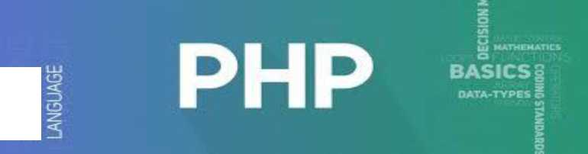

3.2 Tools & Technologies
As from problem statement we will be develop a web portal for our patient and for that web application will be in PHP and For Database Management My SQL
For Server and storing data and information of every User we will use Meghraj initiative cloud by GOI. Also handling this much amount of data will require so much authentication work and for that we have taken Aadhar card for verified user and for privacy purpose we have to give the surety that authentication process will not lose their data elsewhere.
We need to back up all the data of user to make sure any of the situation occurs data must be there and portal should handle the traffic of user data.
11

Slide 8
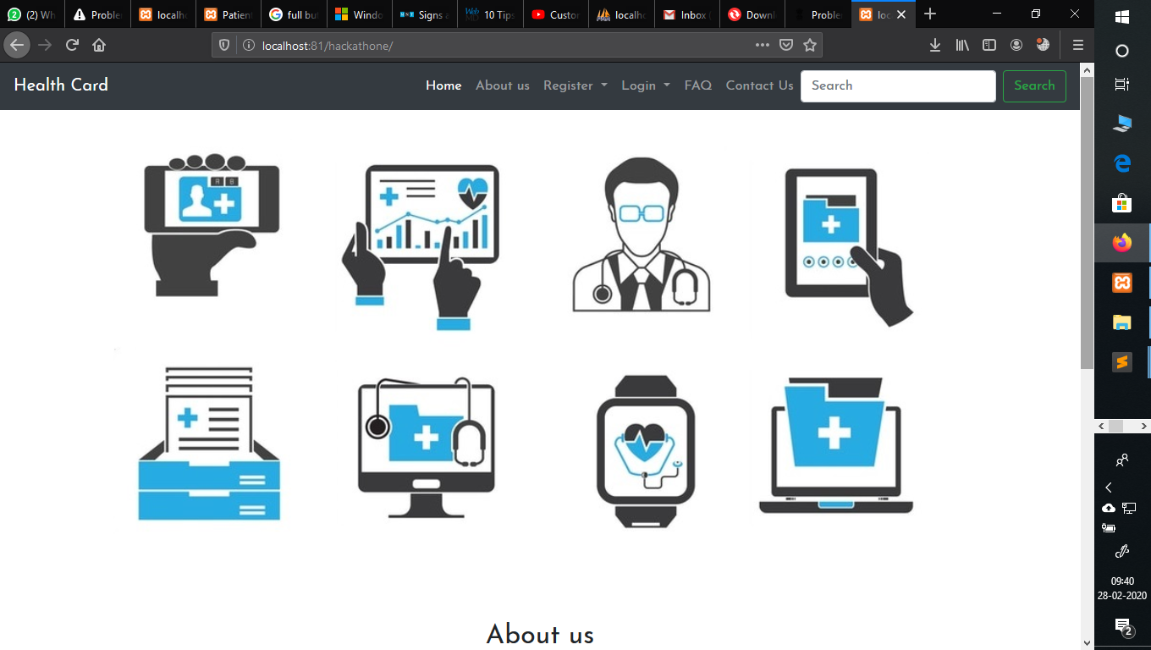
Main page (home page)

Slide 9
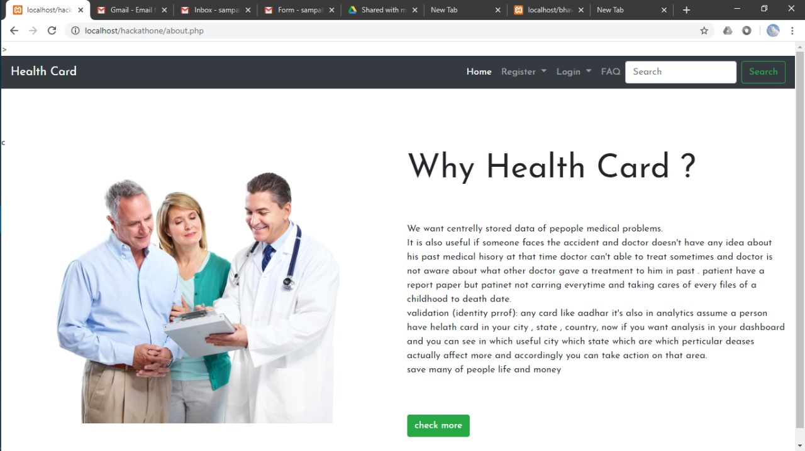
Why health card

Slide 10
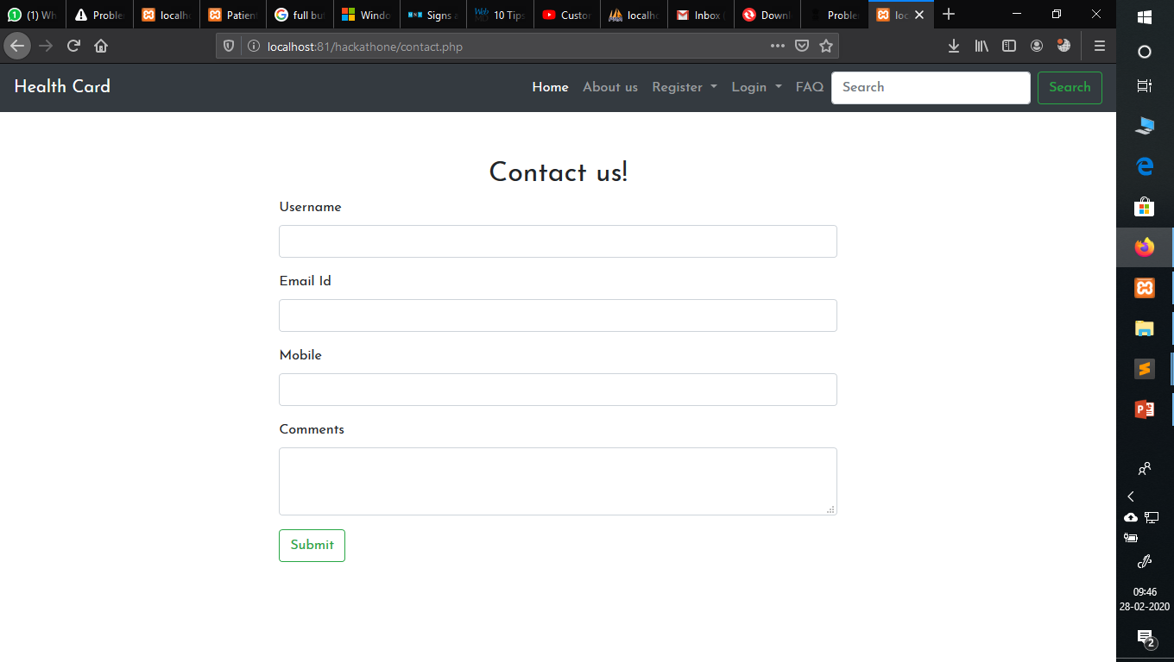
Contact us form

Slide 11
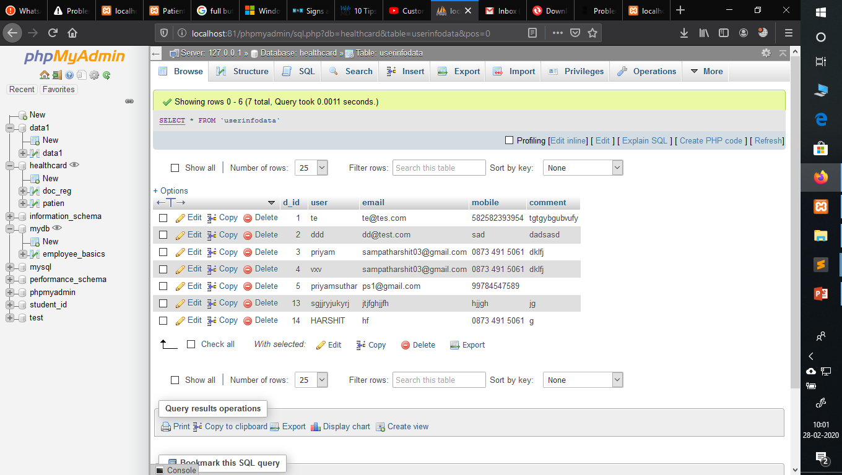
Contact us form database

Slide 12
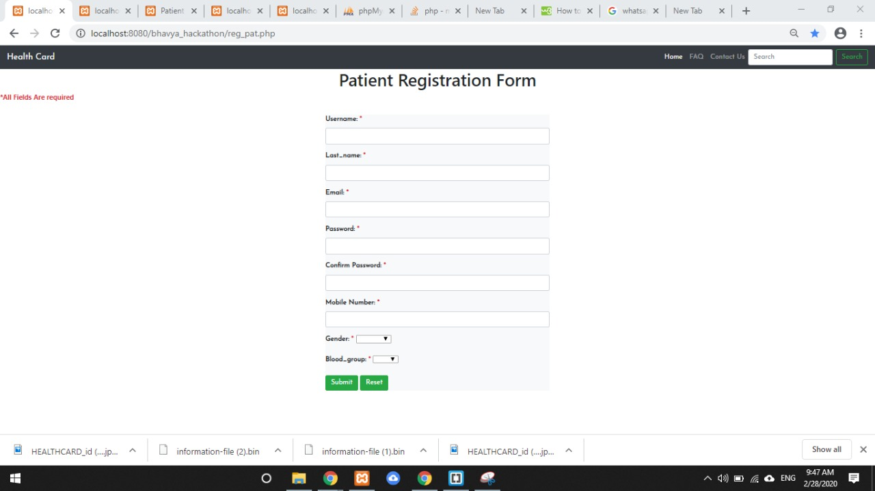
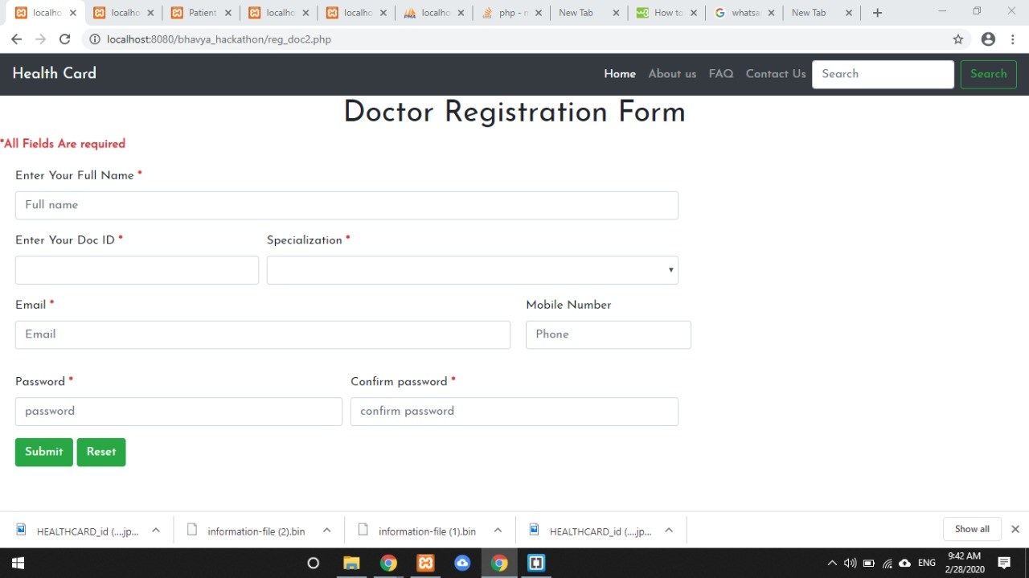
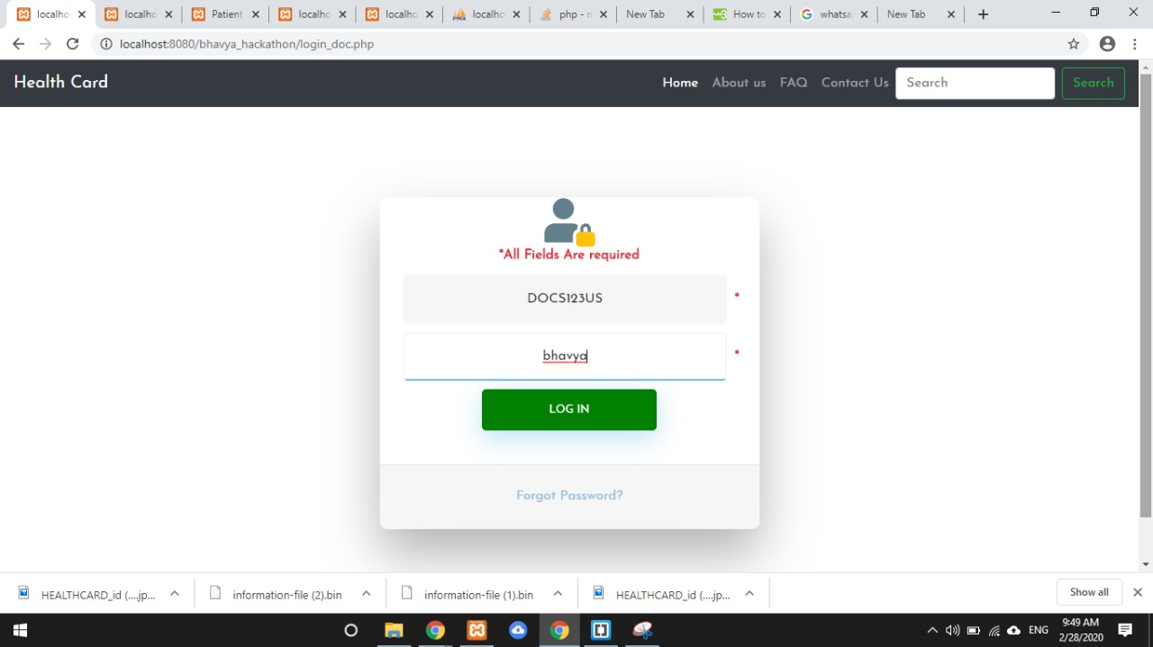
Registration and login(using unique id which will give in user mail id)

Slide 13
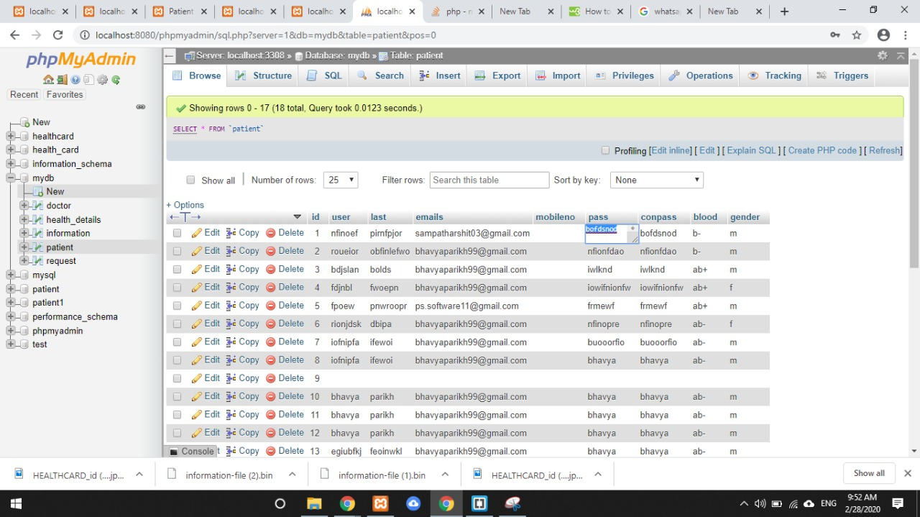
Database of registration

Slide 14
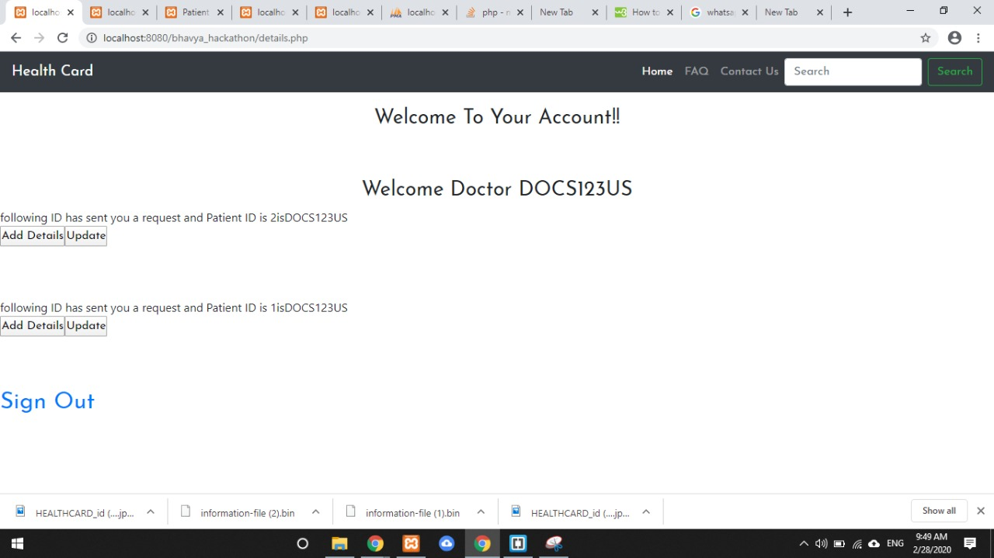
Dashboard of doctor

Slide 15
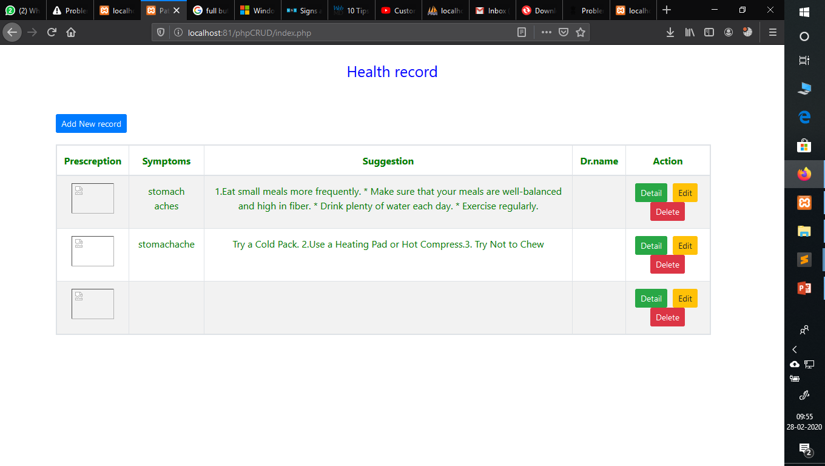
Date wise previously record

Slide 16
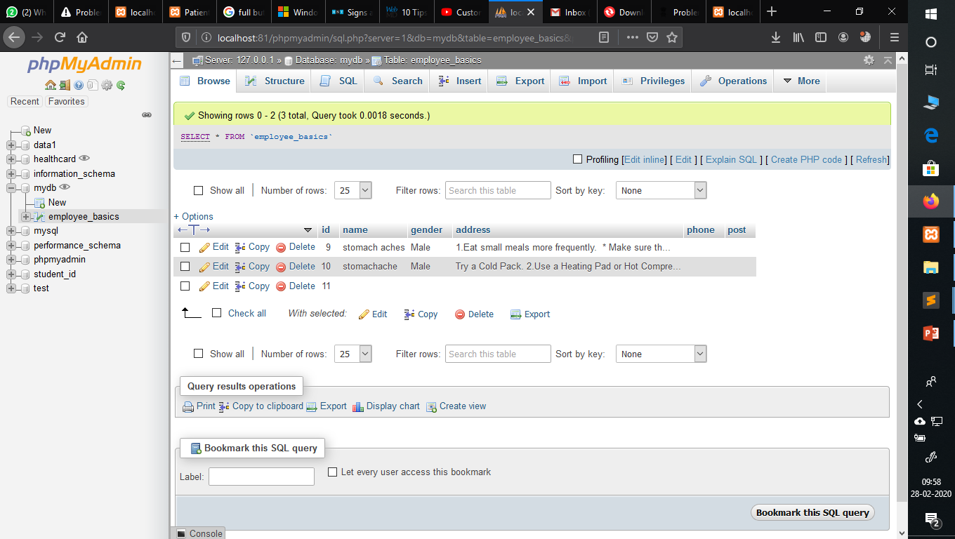

Slide 17
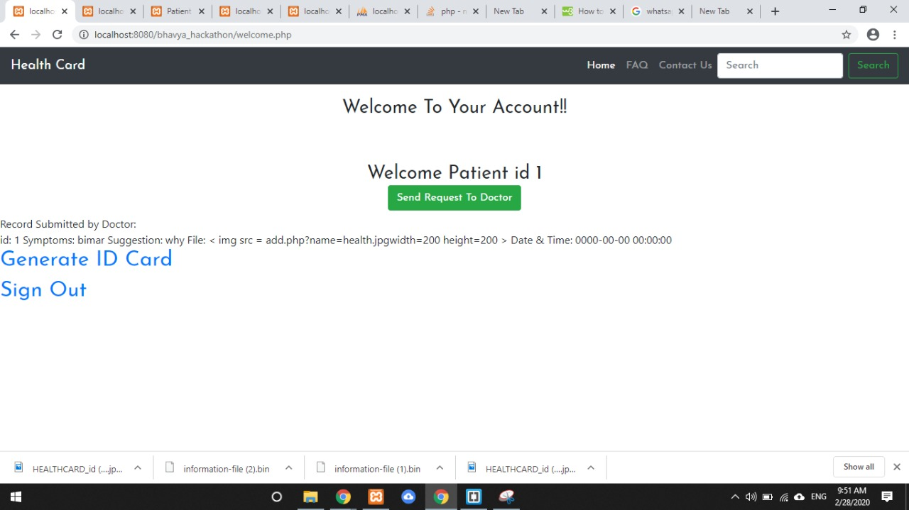
Dashboard of Patient

Slide 18
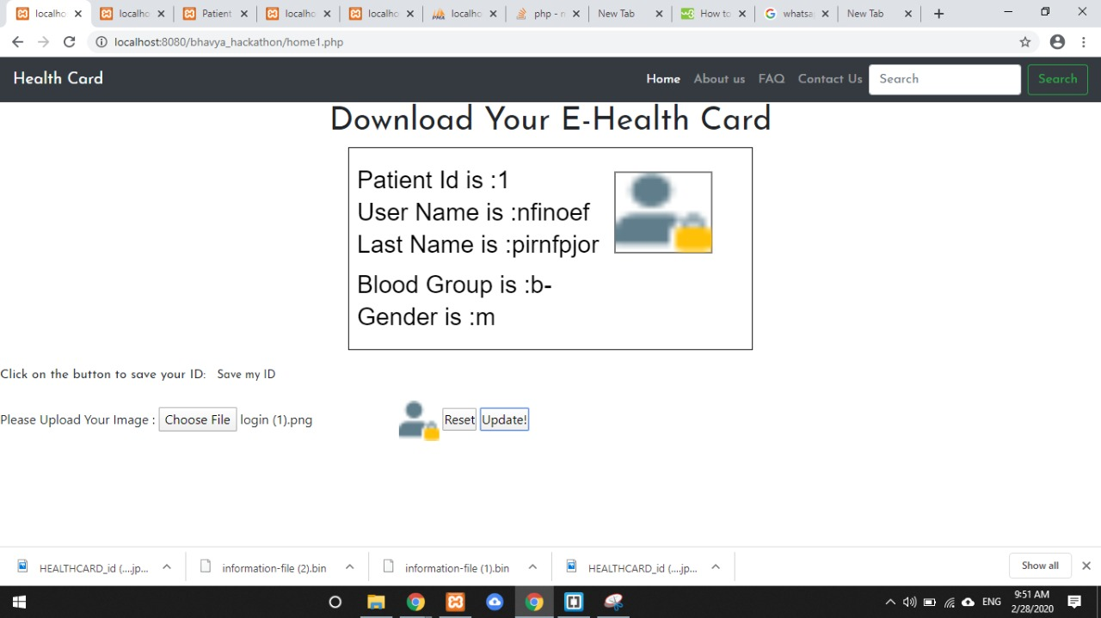
Patient id generate and patient also download id card

Slide 19
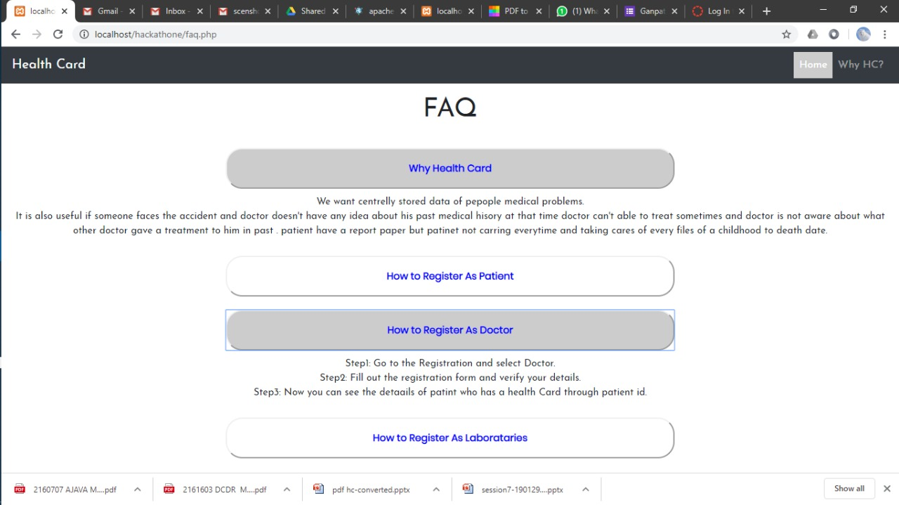

Slide 20
Conclusion
So ,after analysing and discussion on problem statement health card is a very useful and centralized data driven can change patient and hospital relation on basis of files, report because of online platform and single platform can make efficient use and automation can effective work.
Also government can analyse the pattern of dieses and give right steps and encourage to every patient and doctors also can do work with very efficient manner and hospital and clinic can have the data of visiting patient which can really do a lot to them.

Slide 21
Thank you

